Slide 1



Software ENGINEERING
Control Flow Testing by Prof. Mohamad Kassab, Leonidas Kontothanassis kthanasi@bu.edu

Slide 2

Learning Outcomes – Subject Mastery
Develop practical skills in White Box (Structural) Testing, including the analysis of software internals for effective testing.
Master Control Flow Testing as a key White Box technique, enabling systematic exploration of program paths for defect detection.

Slide 3
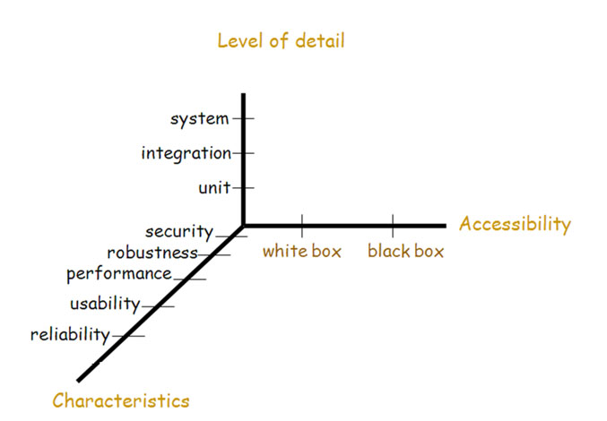
Testing Dimensions

Slide 4
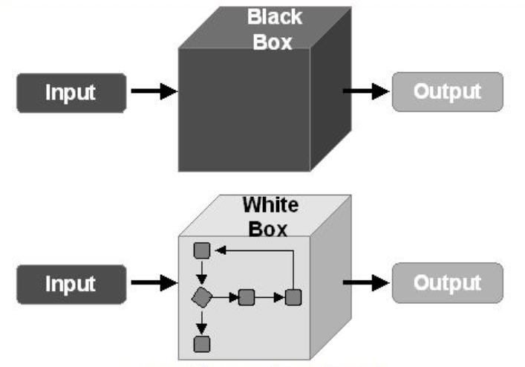
Black Box / White Box Testing

Slide 5
White Box Testing Techniques
Control Flow Testing
Data Flow Testing

Slide 6
what IS Control flow graph?
A graphical representation of a program's control flow structure.
It illustrates the flow of control among the various statements, functions, and modules within a program.

Slide 7
Control Flow Testing: Basic Idea
Two kinds of basic program statements:
Assignment statements (Ex. x = 2*y; )
Conditional statements (Ex. if(), for(), while(), …)
Control flow
Successive execution of program statements is viewed as flow of control.
Conditional statements alter the default flow.

Slide 8
Control Flow Testing: Basic Idea
Procedure node
(out-degree=1)
Start node
(in-degree=0)
Quadruple (E, N, s, t)
N : set of nodes
s: Start node
t: Terminal node
E : set of edges
In-degree (FAN-IN): number of edges arriving at node.
Out-degree (FAN-OUT): number of edges leaving the node.
Path: Sequence of consecutive edges
s
Decision node
(out-degree>1)
Terminal node
(out-degree=0)
t

Slide 9
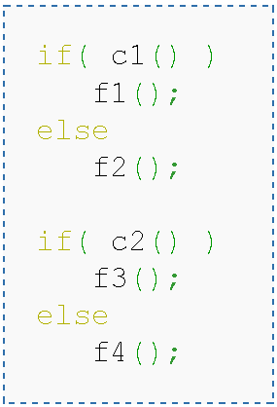
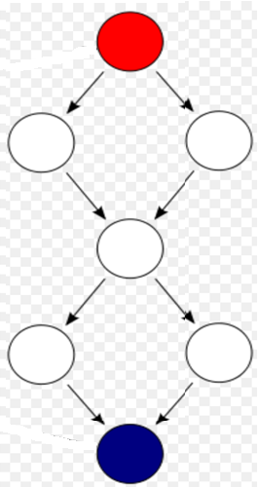
Control flow graph (CFG) Examples
Notes:
Incidence matrix

Slide 10
Control flow graph (CFG) Examples
if (x < y)
{
y = 0;
x = x + 1;
}
else
{
x = y;
}
1
x < y
x >= y
y = 0
x = x + 1
2
3
x = y
4
1
if (x < y)
{
y = 0;
x = x + 1;
}
x < y
y = 0
x = x + 1
2
x >= y
3

Slide 11
Control flow graph (CFG) Examples
x = 0;
while (x < y)
{
y = f (x, y);
x = x + 1;
}
1
x = 0
dummy node
2
x < y
x >= y
implicitly initializes loop
x = 0
1
3
4
y =f(x,y)
x = x + 1
for (x = 0; x < y; x++)
{
y = f (x, y);
}
2
x < y
x >= y
y = f (x, y)
3
5
4
x = x + 1
implicitly increments loop

Slide 12
Control flow graph (CFG) Examples
read ( c) ;
switch ( c )
{
case ‘N’:
y = 25;
break;
case ‘Y’:
y = 50;
break;
default:
y = 0;
break;
}
print (y);
1
read ( c );
c == ‘N’
c == ‘Y’
default
2
3
4
y = 25;
break;
y = 0;
break;
y = 50;
break;
5
print (y);

Slide 13
Example: CFG for ComputeStats
public static void computeStats (int [ ] numbers)
{
int length = numbers.length;
double med, var, sd, mean, sum, varsum;
sum = 0;
for (int i = 0; i < length; i++)
{
sum += numbers [ i ];
}
med = numbers [ length / 2 ];
mean = sum / (double) length;
varsum = 0;
for (int i = 0; i < length; i++)
{
varsum = varsum + ((numbers [ I ] - mean) * (numbers [ I ] - mean));
}
var = varsum / ( length - 1.0 );
sd = Math.sqrt ( var );
System.out.println ("length: " + length);
System.out.println ("mean: " + mean);
System.out.println ("median: " + med);
System.out.println ("variance: " + var);
System.out.println ("standard deviation: " + sd);
}
1
start
2
i = 0
3
i <
length
i >=
length
4
5
i++
i = 0
6
i <
length
i >=
length
7
8
i++
Introduction to Software Testing (Ch 2), www.introsoftwaretesting.com
© Ammann & Offutt
13
Notes:
13

Slide 14
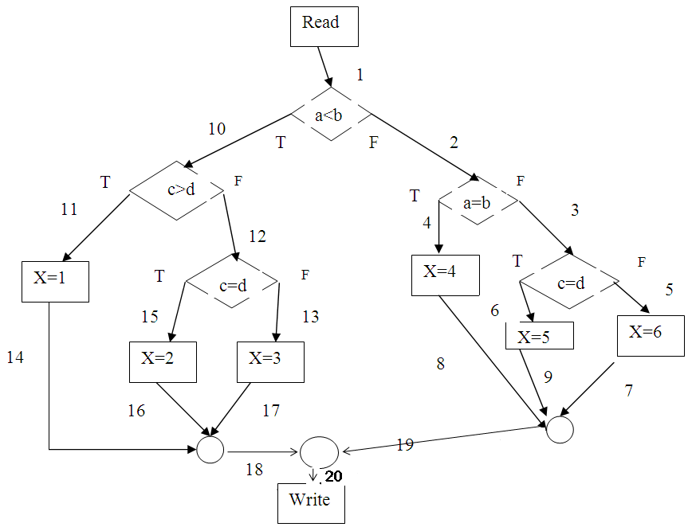
DRAW A CFG !
read(a, b, c, d); if a < b then if c > d then x := 1 else if c = d then x := 2 else x := 3 else if a = b then x := 4 else if c = d then x := 5 else x := 6;
write(x);
Initial node
Decision node
Procedure node
Final node

Slide 15
PROGRAM Path
A program path is a sequence of statements from entry to exit.
There can be a large number of paths in a program.
There is an (input, expected output) pair for each path.
Executing a path requires invoking the program unit with the right test input.
Paths are chosen by using the concepts of path selection criteria.
Tools: Automatically generate test inputs from program paths.

Slide 16
Exercise
What is a possible input for the above program to make it execute the path
(1,10,12,13,17,18,20)
What is the expected output?

Slide 17
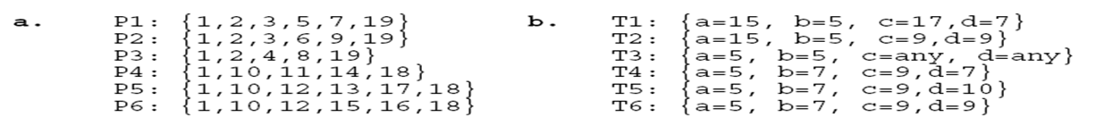
Paths in a Control Flow Graph
A few paths:

Slide 18
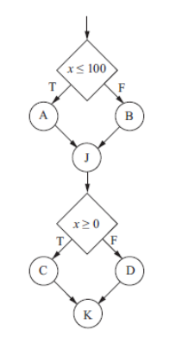
Feasible vs. Infeasible Paths
Two kinds of paths:
Executable path: There exists input so that the path is executed.
Infeasible path: There is no input to execute the path.
Consider the control flow graph shown where: A, B, J, C, D and K are computation nodes that do not affect the value of x.

Slide 19
Outline of Control Flow Testing
The process of generating test input data for control flow testing.

Slide 20
Path Selection Criteria
Program paths are selectively executed.
Question: What paths do I select for testing?
The concept of path selection criteria is used to answer the question.
Advantages of selecting paths based on defined criteria:
Ensure that all program constructs are executed at least once.
Repeated selection of the same path is avoided.
One can easily identify what features have been tested and what not.
Path selection criteria
Select paths to achieve complete statement coverage.
Select paths to achieve complete branch coverage.
Simple Path coverage.
All Path coverage.
Visit each loop
Linearly Independent Paths

Slide 21
Statement coverage criterion
Statement coverage means executing individual program statements and observing the output.
100% statement coverage means all the statements have been executed at least once.
Cover all assignment statements.
Cover all conditional statements.
Less than 100% statement coverage is unacceptable.

Slide 22
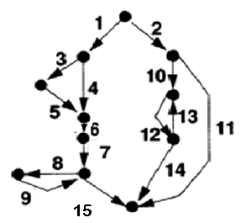
Statement Coverage: Example
Minimum number of test cases: 2
Paths: <2 10 12 14>, <1 3 5 6 7 8 9 15>
Notes:
Set covering problem

Slide 23
Branch coverage criterion
A branch is an outgoing edge from a node in a CFG.
A condition node has two outgoing branches corresponding to the True and False values of the condition.
Covering a branch means executing a path that contains the branch.
Find a set of paths such that every edge lies on at least one path
100% branch coverage means selecting a set of paths such that each branch is included on some path.

Slide 24
Branch Coverage: Example
Minimum number of test cases: 4
Paths: <2 11>, <2 10 12 13 12 14>, <1 3 5 6 7 15>, <1 4 6 7 8 9 15>
Notes:
NP complete in the worst case (SAT Constraint solver).

Slide 25
Simple Path Coverage
Strategy:
every simple path (which does not contain the same edge more than once) is executed once

Slide 26
Simple Path Coverage: Example
Minimum number of test cases: 6
Paths: <2 11>, <2 10 12 14>, <1 3 5 6 7 15>, < 1 4 6 7 15>, <1 3 5 6 7 8 9 15>, <1 4 6 7 8 9 15>
Notes:
NP Hard algorithm

Slide 27
All Path Coverage
Strategy:
every possible program path is executed at least once
In terms of flowgraph: find all DD-paths through the flowgraph
Notes:
DD = Definition Definition paths.

Slide 28
All Path Coverage: Example
Minimum number of test cases: Infinite
Paths: <2 11>, <2 10 12 14>, <2 10 12 (13 12)^{n} 14>, <1 3 5 6 7 15>, < 1 4 6 7 15>, <1 3 5 6 7 (8 9)^{n} 15>, <1 4 6 7 (8 9)^{n} 15> (any n>0)

Slide 29
Visit-Each-Loop Coverage
Strategy:
skip the loop entirely
only one pass through the loop
Notes:
If loops are nested this results in the same multiplicity of test cases we’ll find with boundary value analysis

Slide 30
Visit-Each-Loop Coverage: Example
Minimum number of test cases: 7
Paths: <2 11>, <2 10 12 14>, <2 10 12 13 12 14>, <1 3 5 6 7 15>, < 1 4 6 7 15>, <1 3 5 6 7 8 9 15>, <1 4 6 7 8 9 15>

Slide 31
Linearly INDEPENDENT PATHS coverage
Two or more paths are considered independent if one cannot be derived from the other. In other words, each path represents a unique combination of decisions and conditions within the program.

Slide 32
Linearly Independent Paths
def example_function(a, b):
if a > 0:
# Path A
print("Path A: a is greater than 0")
if b > 0:
# Path C
print("Path C: b is greater than 0")
else:
# Path D
print("Path D: b is less than or equal to 0")
else:
# Path B
print("Path B: a is less than or equal to 0")

Slide 33
McCabe’s Cyclomatic Complexity

Slide 34
McCabe Example
A program fragment : all variables are int
1. i=1;
2 if (a< b)
3 a=a+b;
4 else
5 b=a+c;
6 while (i<20)
7 {
8 if (b<c)
9 {
10 if (b>c)
11 b=b+a;
12 }
13 else
14 c=b+a;
15 i++;
16 }
I added line numbers for ease of analysis

Slide 35
Condense line numbers together as follows:
A=1,2;
B=3;
C=4,5;
D=6,7,8;
E=9,10;
F=11;
G=12,15,16, and
H=13,14
11 edges
8 nodes
A
1. i=1;
2 if (a< b)
3 a=a+b;
4 else
5 b=a+c;
6 while (i<20)
7 {
8 if (b<c)
9 {
10 if (b>c)
11 b=b+a;
12 }
13 else
14 c=b+a;
15 i++;
16 }
B
C
D
Noted: You can draw a graph that assigns a node to each syntactic element of the program (including { and }, which had 16 nodes and 19 edges
This is a perfectly correct approach, and you are less likely to make mistakes this way.
For efficiency, however, I chose to condense line numbers.)
E
H
F
G

Slide 36
Example, Continued
From the graph we can see that e=11 and n=8.
Now with c=e-n+2 we have c=11-8+2 = 5.
As a check, you can count the number of simple branches (if and while statements without complex predicates) and add one to it. There are 4 simple branches so c=4 + 1 = 5.

Slide 37
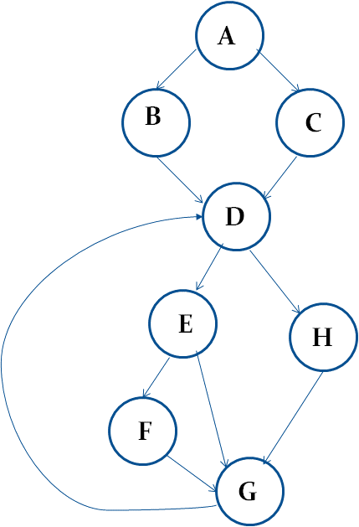
Linearly Independent Paths
The cyclomatic complexity of a section of source code is the maximum number of linearly independent paths within it—where "linearly independent" means that each path has at least one edge that is not in one of the other paths.
One set of 5 independent paths is:
1: ABDEFGD…
2: ABDEG…
3: ABDHG…
4: ACDE…
5: ACDHG…
List the independent code paths in this code.
Note that path 4 covers both ACDEFGD…and ACDEG …because DEFGD and DEG are in paths 1 and 2. Now, converting A-G to their corresponding line numbers gives the test paths in terms of the code.
Note: you can get a different set that is also correct – for a code graph vector space there can be more than one basis set.

Slide 38
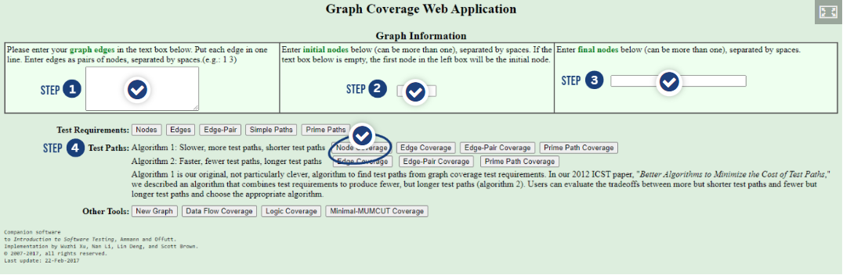
Graph Coverage Web Application
Several powerful tools are available to assist in graph testing.
For example, one tool is provided by the authors of the book for free through the web at: https://cs.gmu.edu:8443/offutt/coverage/GraphCoverageLinks to an external site.

Slide 39
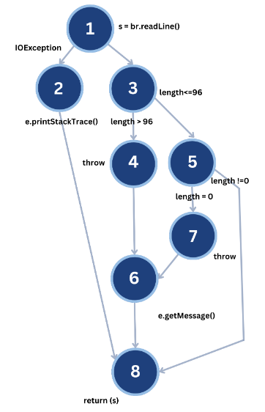
GRAPH COVERAGE WEB APPLICATION
try {
s = br.readLine();
if (s.length() > 96)
throw new Exception (“too long”);
if (s.length() == 0)
throw new Exception (“too short”);
} (catch IOException e) { e.printStackTrace();
} (catch Exception e) {
e.getMessage();
}
return (s);

Slide 40
CONTROL FLOW TESTING TOOLS
EclEmma: EclEmma is an Eclipse plug-in for Java code coverage analysis. While it primarily focuses on coverage analysis, it also provides features for generating JUnit test cases that aim to increase code coverage, including control flow paths.
JCrasher: JCrasher is a Java unit testing tool that automatically generates test cases to exercise various control flow paths in Java programs. It uses a combination of random testing and control flow analysis techniques to create tests that aim to achieve high code coverage.
CUTE (C Unit Testing Easier): CUTE is a unit testing framework for C and C++ programs that can be used to automate control flow testing. It provides facilities for generating and executing test cases automatically to cover different control flow paths in C/C++ code.

Slide 41
CONTROL FLOW TESTING TOOLS
Testwell CTC++ (C/C++ Test Coverage for C++ and C): Testwell CTC++ is a code coverage tool for C and C++ programs that can be used to automate control flow testing. It provides features for generating test cases and executing them to achieve high coverage of control flow paths.
Hansel: Hansel is a tool for automatic test case generation in Java. It uses symbolic execution techniques to explore different control flow paths in Java programs and generate test cases that aim to achieve high code coverage.
PathCrawler: PathCrawler is a tool for automatic test case generation in Java. It uses symbolic execution and constraint solving techniques to explore different control flow paths in Java programs and generate test cases that aim to achieve high coverage.

Slide 42

Which Coverage Criterion to select?
1. The Complexity of Software Artifact
2. Criticality of the Software Artifact
3. Resource Availability and Cost Considerations
4. Level of Trust

Slide 43
Code coverage requirements
Low code coverage indicates inadequate testing, but 100% coverage is impossible in practice and generally not cost effective.
Although 100% code coverage may appear like a best possible effort, even 100% code coverage is estimated to only expose about half the faults in a system.
Code coverage of 70-80% is a reasonable goal for system test of most projects with most coverage metrics.
Empirical studies of real projects found that increasing code coverage above 70-80% is time consuming and therefore leads to a relatively slow bug detection rate

Slide 44
Minimum Acceptable Code Coverage Standards
The aviation standard DO-178B requires 100% code coverage for safety critical system
The standard IEC 61508:2010 "Functional Safety of Electrical/Electronic/Programmable Electronic Safety-Related Systems" recommends 100% code coverage of several metrics, but the strenuousness of the recommendation relates to the criticality.
The IEEE Standard for Software Unit Testing section 3.1.2 specifies 100% statement coverage as a completeness requirement. Section A9 recommends 100% branch coverage for code that is critical or has inadequate requirements specification.

Slide 45
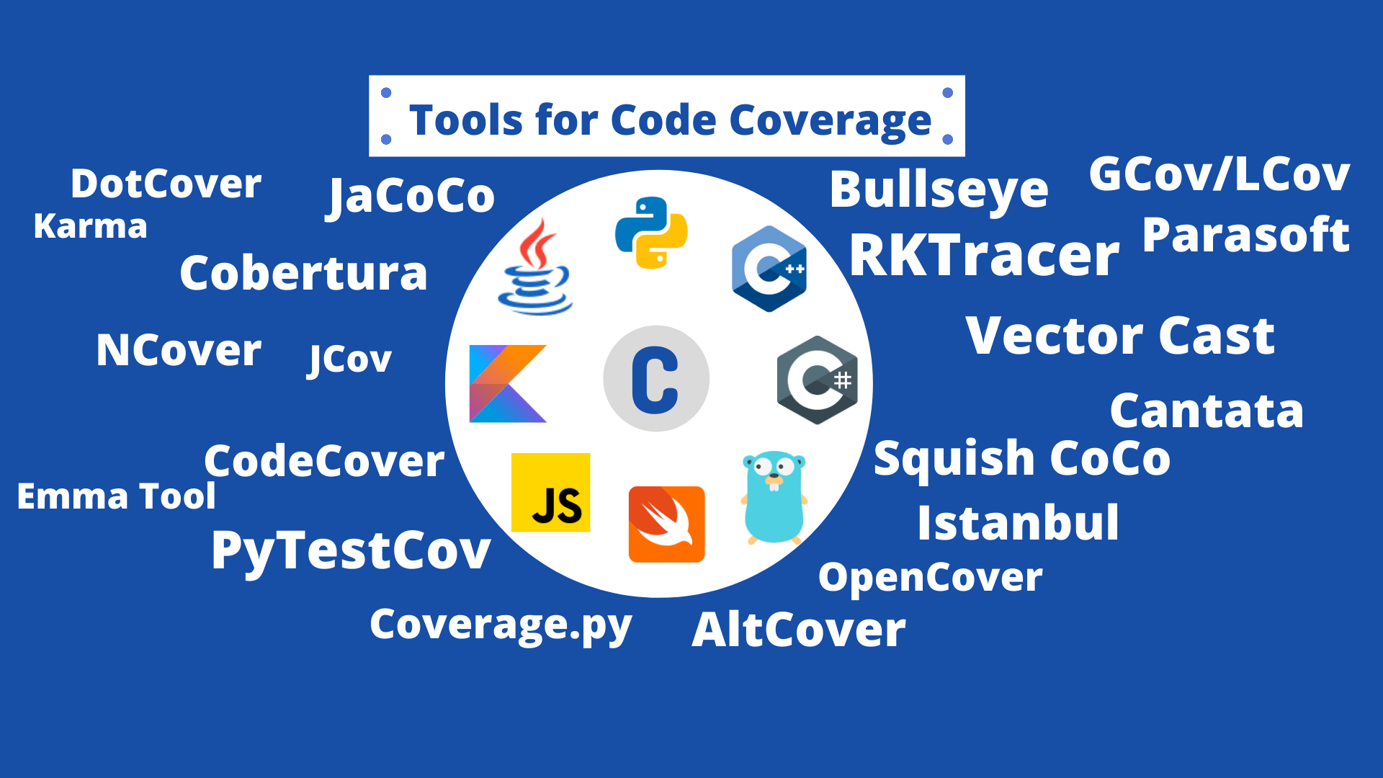
Code Coverage Tools
Industry’s messy answer to a lot of the nice theories
Will typically tell what fraction of your code lines has been covered by the tests you have written, sometimes will cover branches, rarely will they cover paths!

Slide 46
Code Coverage Tools
Python
pip install coverage
coverage run –m pytest
coverage report
Assumes you are using pytest
pip install pytest Write test files next to your code names test_file.py Name your test functions test_xxx() Functions that trigger an assert fail, those that don’t succeed.
File | Statements | Missed | Coverage
app/init.py | 2 | 0 | 100%
app/models.py | 58 | 5 | 91%
app/views.py | 80 | 12 | 85%
app/utils/helpers.py | 40 | 0 | 100%
TOTAL | 180 | 17 | 91%

Slide 47
Code Coverage Tools
Java
Depends on your build tools. Good support for Maven and Gradle.
https://maven.apache.org/download.cgi
In your project configuration file (pom.xml) add the JaCoCo plugin dependency.
Then run
mvn clean test to run all tests
mvn verify to generate the report
Assumes tests written in the JUnit framework.
JaCoCo Coverage Report
Session: TestSession
Date: 2025-08-19 14:25:30
Element Missed Instructions Cov. Missed Branches Cov. Complexity Lines
----------------------------------------------------------------------------------
All classes 245 78% 58 72% 1.7 80%
com.example.app.model 12 95% 0 100% 1.0 97%
com.example.app.service 85 70% 25 65% 2.3 74%
com.example.app.controller 148 65% 33 60% 3.1 68%
----------------------------------------------------------------------------------

Slide 48
Knowledge Check
In the control flow graph shown, A, B, C, D and J are computation nodes that do not affect the value of variable x.
If there is no limit to the number of test case, how many different feasible execution paths can be tested?

Slide 49
Knowledge Check
In the control flow graph shown, A, B, C, D and J are computation nodes that do not affect the values of variables x, y.
If there is no limit to the number of test case, how many different independent paths can be tested?
y

Slide 50
Knowledge Check
Which of the following statements are true?
100% branch coverage guarantees 100% All paths coverage.
100% statement coverage guarantees 100% branch coverage.
100% statement coverage guarantees 100% All paths coverage.
100% branch coverage guarantees 100% statement coverage.
Notes:
False. Branch coverage only requires you hit the branch conditions independently but in combination.
False. There can be branch paths that do not include any statements so you might miss those (if without else)
Of course not since if you can’t cover branches you can’t cover all paths
True. If you go through every path branch then you must hit all statements at least once.

Slide 51
Knowledge Check
You have been asked by your supervisor to "exhaustively test" the software for a mission critical system using All-Paths testing. What is the most appropriate response to give to the supervisor?
It is impossible to do this kind of testing
All-paths testing can be completed in a reasonable amount of time without even using automation.
All-paths testing can be performed but will take forever.
All-paths testing can be performed on small portions of the most critical code using automation and given enough time.

Slide 52
Control Flow Testing comparison
Criterion | Strength | Feasibility | Recommended use
Statement Coverage | * | Easy | For simple sanity tests, smoke tests
Branch Coverage | ** | Easy | Standard baseline for most unit/integration testing frameworks
Linearly Independent Paths (Basis Path Testing) | *** | Moderate | Recommended for critical or safety-critical code; covers all branches and logical structures with minimal tests
Visit-Each-Loop Coverage | *** | Moderate | Recommended for loop-heavy algorithms to avoid infinite “all-paths” explosion
All-Paths Coverage | ****** | Impractical | Only for tiny programs or formal verification tools

Slide 53
Summary
Control flow is a fundamental concept in program execution.
A program path is an instance of execution of a program unit.
Select a set of paths by considering path selection criteria.
Statement coverage
Branch coverage
Predicate coverage
All paths
From source code, derive a CFG (compilers are modified for this.)
Select paths from a CFG based on path selection criteria.
Extract path predicates from each path.
Solve the path predicate expression to generate test input data.
There are two kinds of paths.
feasible
infeasible

Slide 54
What about Data Flow?
Even harder and outside the scope of a practical class
You need to identify Definition/Use pair for the variables you care
Compute a feasible path between them
Construct other variable predicate values that can force execution through the path (many values)
Inject code before the use that verifies the use site really receives the value created in the define site
Generally, there are 3 types of problems with dataflow
du (defined and undefined before it is used)
dd (defined twice without being used)
ur (used before being defined)
Generally, don’t bother unless it’s a homework question ☺
If you care pysa is a decent tool for finding data flow issues in Python and CodeQL for Java.

Slide 55

Questions

